Slide 1
(Java Application Game)

Slide 2
INTRODUCTION
Dive into intense tank-on-tank war and enjoy an amazing thrill of battle field.
Tank Wars is two player game which is an action game dedicated to armored war. This game is designed in Java and provides full screen support. Destroy the opponent’s tank by firing a weapon. Each player will get points on destroying opponent’s tank. And the one with highest score is declared as a winner.

Slide 3
How To Play Tank Wars

Slide 4
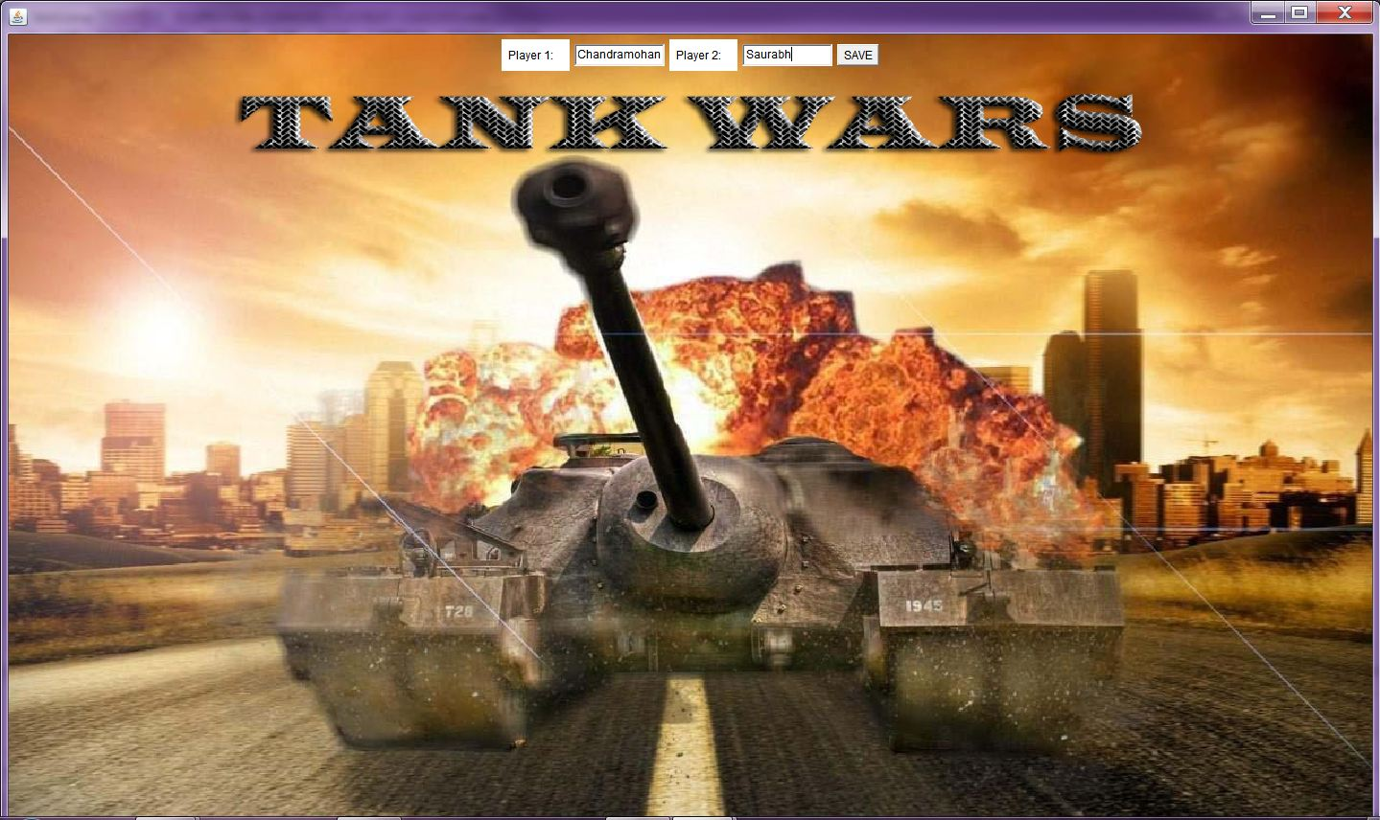
At the starting the players have to enter their names.
Then hit the “SAVE” button and the game will be started and the players name are stored to database.

Slide 5
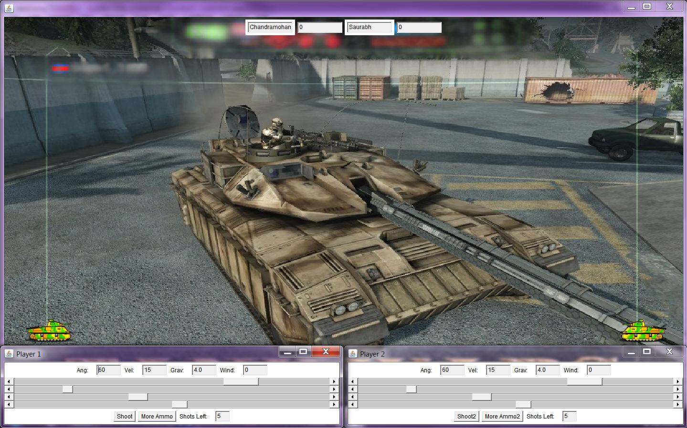
Each player has one tank and five shots to shoot the opponent’s tank.
To destroy the target the players have facility to change the cannon angle.
The angle can be set from 1 degree to 80 degrees using simple scroll bars.
Then the player have to choose the velocity of weapon.
This velocity can be chosen from limit 1 to 58 using scroll bar.

Slide 6
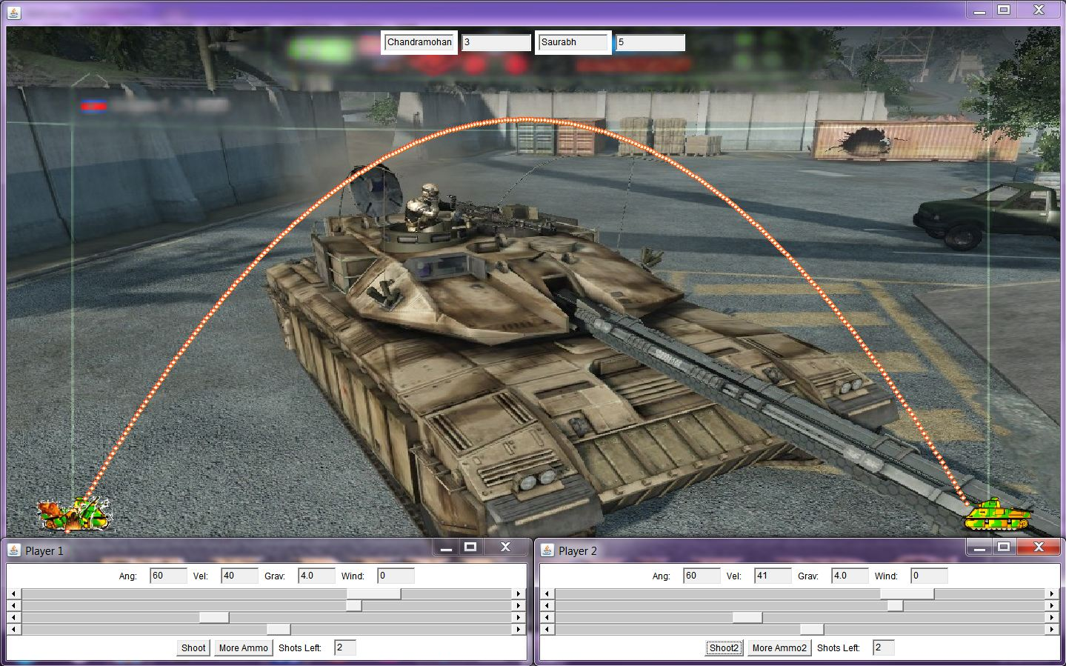
Then the last thing the players have to do is to hit the “Shoot” button, and then the weapon will be fired and will hit the target according to the angle and the velocity of the weapon.
If the target is destroyed successfully then the player’s score is updated using the hit position and the will be scored accordingly. That score is stored in database with its name and the number of shots will decreased by one.

Slide 7
The new exciting features of Tank Wars
In this game you can experience the difficulties of war field which includes wind.
Another Exciting feature is you can experience the magic of gravity.
After firing all 5 shots the player have freedom to add more ammo to his tank using “MORE AMMO” button.

Slide 8
FEASIBILITY STUDY
Technical Feasibility:
The software or tools necessary for running the application are easily available.
This game has been built using Java which is platform independent hence there are no compatibility issues.
Hence, the developed application is technically feasible.

Slide 9
FEASIBILITY STUDY
Economical Feasibility
The cost of required hardware and software is affordable.
High increase in the amount of profit earned can be achieved by selling the application using internet.
The price can be kept cheap.

Slide 10
FEASIBILITY STUDY
Operational Feasibility
This application is made by using simple GUI, hence it is very convenient to use for everyone who has basic knowledge of using computer.
The manual is provided with the application, so everyone can understand the rules of the game.

Slide 11
APPLICATION REQUIREMENTS
Hardware Requirement
Processor : Pentium IV or Any Higher Version
Hard Disk : 20GB min.
Ram : 512 Min.
Monitor : With minimum 1024 X 768 resolutions.
(Higher Resolution is recommended.)
Software requirement
Operating System : Windows, MAC
Database : MS-Access
Java Development Kit : Java JDK 1.6 or higher

Slide 12
Scope and limitations
There is no scope to save the game. The ‘save and exit’ feature is not provided. This means that a previously played game cannot be reloaded.
There is no facility to choose levels.
There is no provision to store the high scores of the previously played games.

Slide 13
Future Enhancement
The game will have different levels.
The player will have different weapons.
The player will be provided with the freedom of moving his/her tank in reverse and forward direction to defend his/her tank from opponent.
Sounds will be added to enhance the feel of war field while playing the game.
The game can be played over a LAN.
The ‘save’ and ‘save and exit’ features would be added to add more flexibility to this game.

Slide 14
Conclusions
From a proper analysis of positive points and constraints on the component, it can be safely concluded that the product is a highly efficient GUI based component. This application is working properly and meeting to all user requirements. This component can be easily plugged in many other systems .

